Slide 1

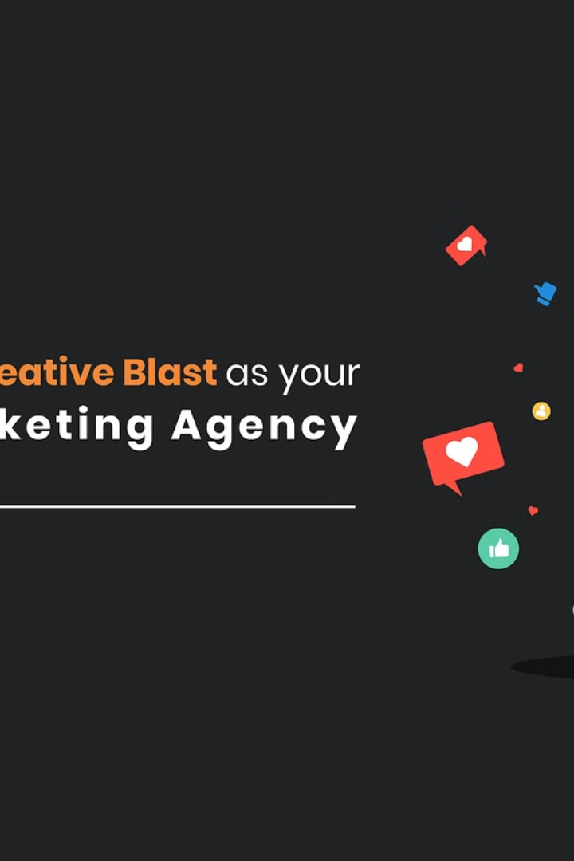


A Digital Marketing Agency Dedicated to Your Success
by Aditya Gawade

Slide 2
Our Services
Search Engine Optimization
Social Media Marketing
Content Creation
Develop compelling, value-driven content that resonates with your customers and drives conversions.
Improve your online visibility and attract more qualified leads through strategic SEO techniques.
Engage your target audience and build brand loyalty across leading social platforms.

Slide 3
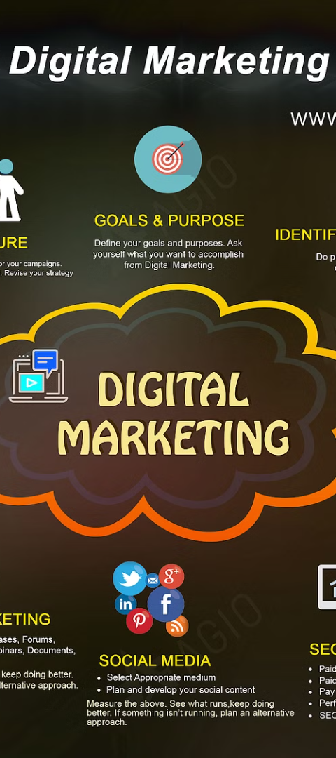
Our Approach
1
Understand
We start by deeply understanding your business, goals, and target audience.
2
Strategize
We develop a custom digital marketing strategy tailored to your unique needs.
3
Execute
Our team of experts executes the strategy, continuously optimizing for maximum impact.

Slide 4
Our Clients
Startup Success
Enterprise Leaders
We've helped numerous startups establish a strong online presence and accelerate growth.
Our proven strategies have driven measurable results for large, established brands.
Diverse Industries
Glowing Testimonials
We've served clients across a wide range of industries, from e-commerce to SaaS.
Our clients consistently praise our expertise, creativity, and commitment to their success.

Slide 5
Our Results
1
Increased Website Traffic
2
Higher Conversion Rates
Our strategies have driven up to 300% increase in organic website traffic for clients.
We've helped clients achieve up to 50% improvement in lead generation and sales.
3
Stronger Brand Awareness
4
Measurable ROI
Our campaigns have boosted brand recognition and reputation for our clients.
We track and report on key metrics to ensure our work delivers tangible, measurable results.

Slide 6




Our Team
Creative Innovators
Data-Driven Experts
Collaborative Partners
Passionate Advocates
Our team of marketing creatives constantly push the boundaries of what's possible.
We leverage cutting-edge data and analytics to optimize performance and ROI.
We work closely with clients as an extension of their team, not just a vendor.
Our team is deeply invested in the success of every client we serve.

Slide 7




Our Process
Discover
Strategize
Implement
Analyze
We dive deep to understand your business, goals, and target audience.
Our experts develop a customized digital marketing plan to drive results.
We execute the strategy with precision and agility, continually optimizing.
We track and report on key metrics to ensure maximum ROI for your investment.

Slide 8
Contact Us
Phone:
555-555-5555
Email:
info@digitalagency.com
Address:
123 Main Street, Anytown USA
Ready to take your digital marketing to new heights? Contact us today to schedule a consultation and learn how we can help your business succeed.

